Slide 1
Predicting Chicago’s Power Needs
By Abby Roberts

Slide 2

The Problem
Notes:
https://www.theblackoutreport.co.uk/2019/11/11/northeastern-blackout-usa-canada-1965/

Slide 3
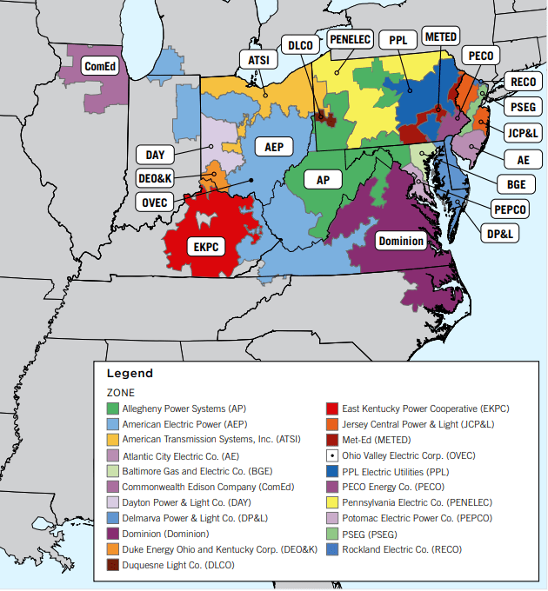
The Model
Predict power for Chicago (ComEd)
Part of PJM Interconnection
Notes:
https://www.pcienergysolutions.com/2024/01/03/what-is-pjm-and-what-does-it-do/

Slide 4
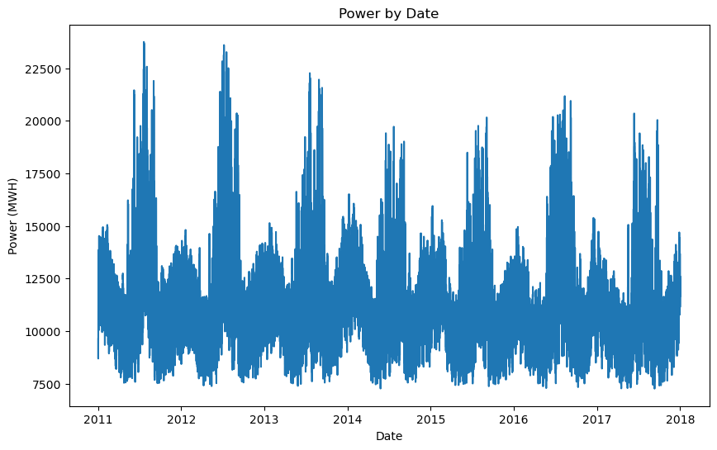
Data Collection
Actual power usage
Hourly weather data
Yearly census data

Slide 5
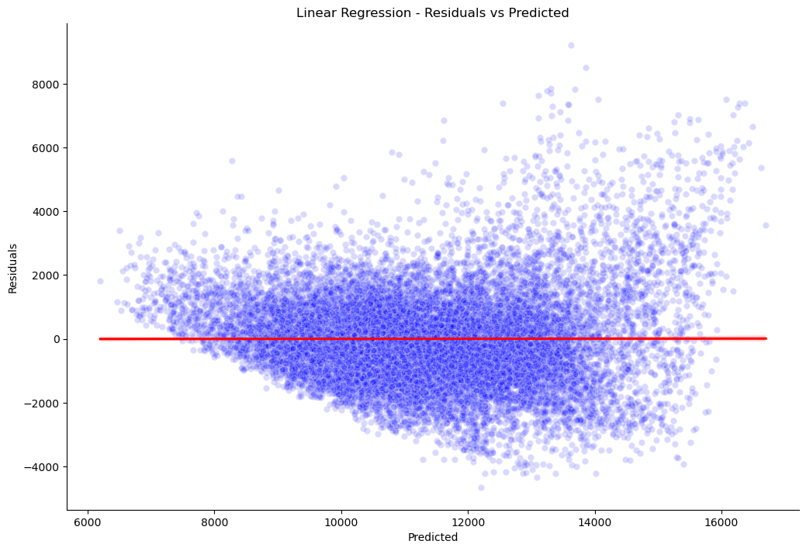
Initial Model
Linear model
R² = 0.577

Slide 6
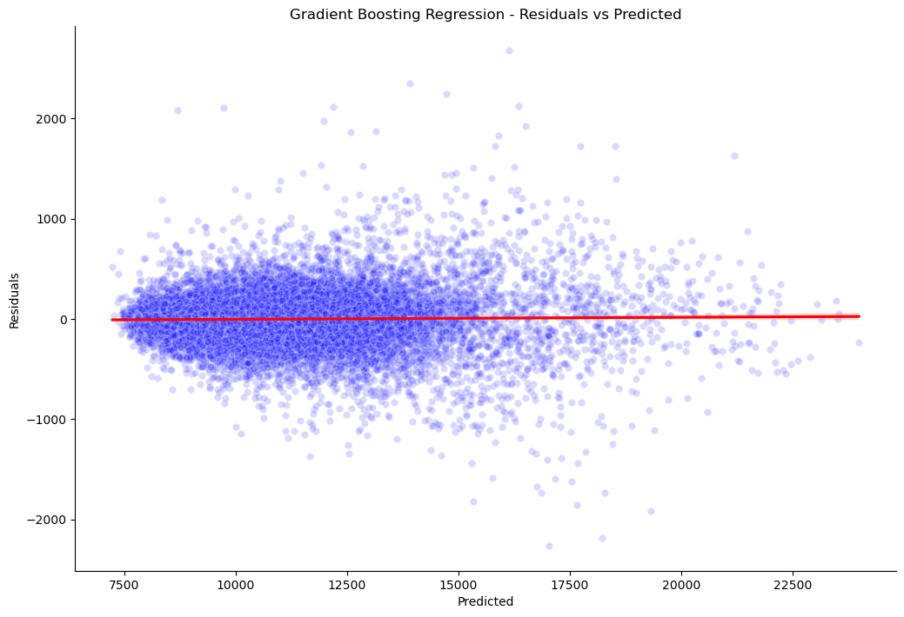
Improved Model
Gradient boosting regression model
R² = 0.985

Slide 7
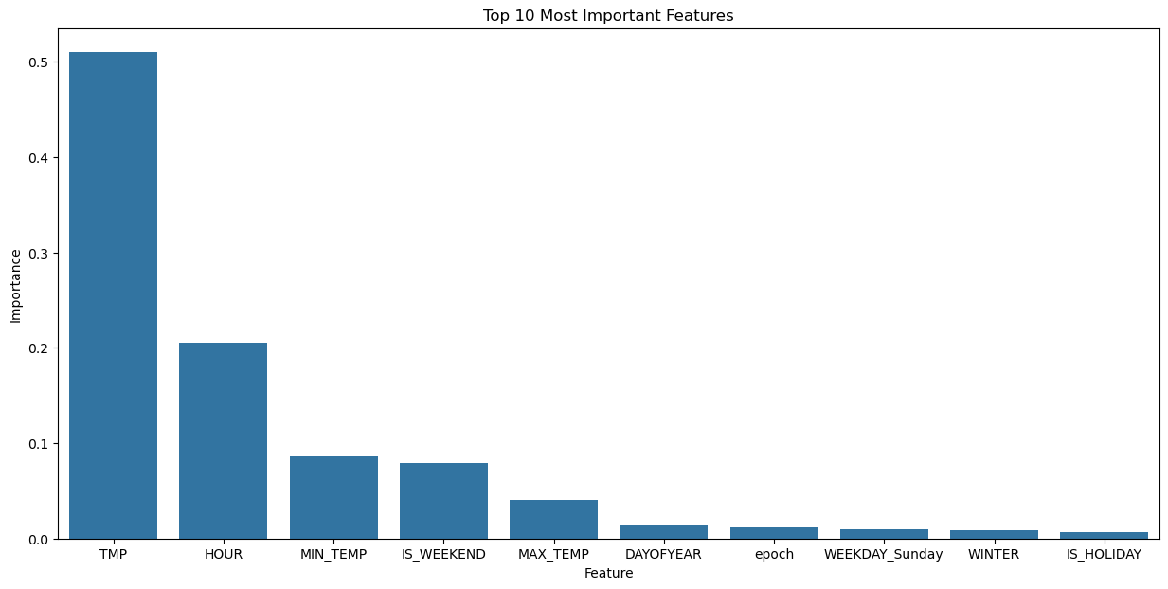
Improved Model
Most important feature is temperature by far
Hour, weekend, and season also important

Slide 8
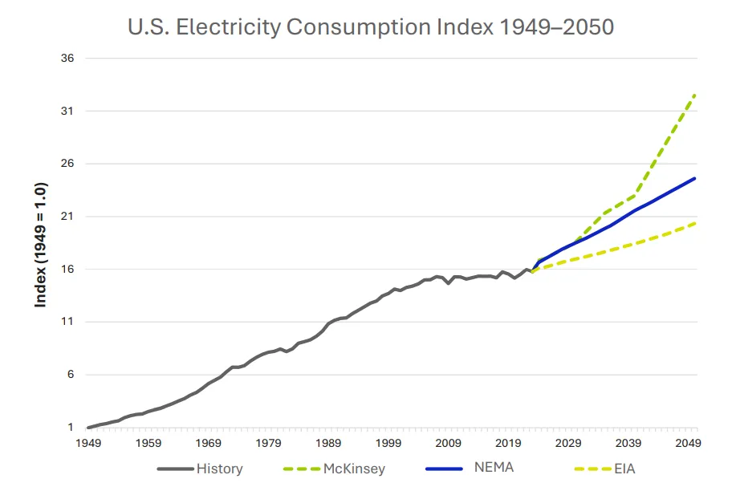
Challenges and Limitations
Data only runs from 2011-2017
Only looked at Chicago
Notes:
https://www.utilitydive.com/news/us-electricity-demand-will-grow-50-by-2050-electrical-manufacturer-study/744575/

Slide 9
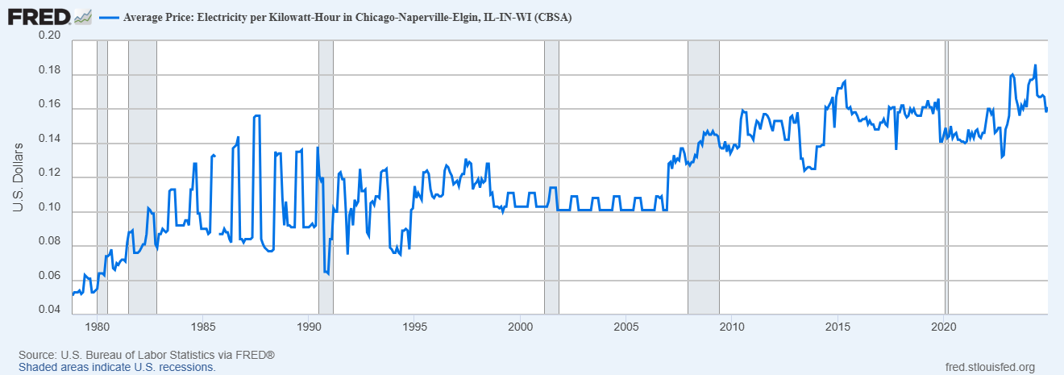
Final Thoughts
R² = 0.985 good, but can be improved
Accuracy is very important
Notes:
https://fred.stlouisfed.org/series/APUS23A72610

Slide 10
Thank You!

